Slide 1




Semi-Supervised Learning Approach to predict dry beans
Seema Bhandari, Yamuna Dhungana, Rylie Fleckenstein, Roshni Sharma, Lilibeth Lumbreras

Slide 2
Table of Content
Overview/Problem Background
The Data & Observations through Exploratory Analysis
Methods/ Models
Model Building Process
Neural Network
Linear Discriminant Analysis
K-Nearest Neighbors
Support Vector Machine
Random Forest
Model Comparison
Recommendation
References

Slide 3
Overview/Problem Background
Turkey is highest cultivator of dry beans in the world. Varieties of beans are cultivated during harvest.
Market value of dry beans seeds are dependent on separability between the different varieties of seeds.
The net worth of a sample of seeds decreases if there is no clear identification between the seeds.
Aim: to design a classifier that will predict the type of beans for the given samples and estimate the accuracy of the predicted value of a pound of beans for each sample.

Slide 4
The Data (labeled/Sample)
One labeled dataset: With all 6 varieties of white beans labeled.
3000 observations with eight variables: Class, Area, Perimeter, MajorAxisLength, MinorAxisLength, Eccentricity, ConvexArea, and Extent
Three unlabeled sample datasets: given to classify the bean varieties and predicting each set’s estimated net worth.
By exploration, we found that some variables are extremely separable.

Slide 5
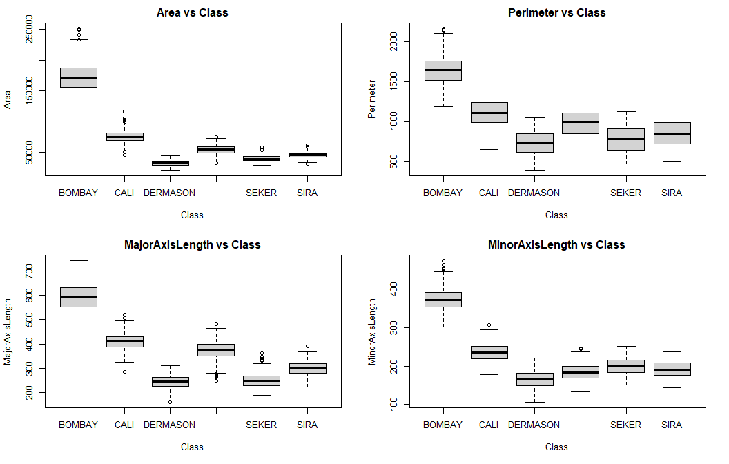
Observations through Exploratory Analysis

Slide 6
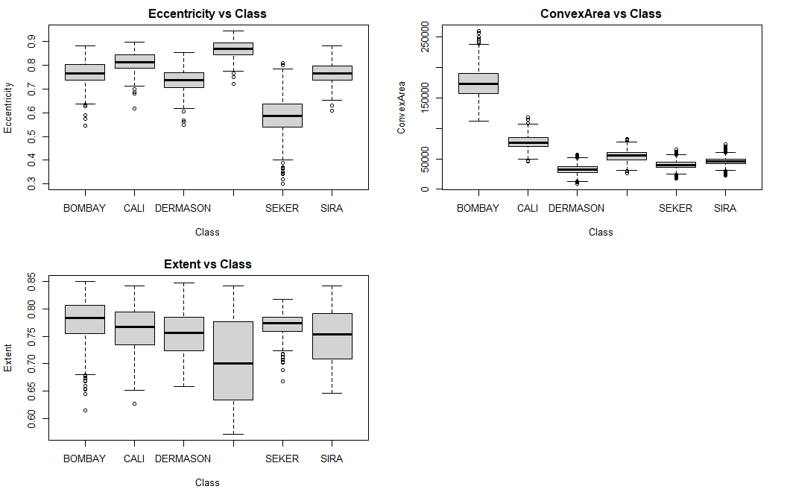
Observations through Exploratory Analysis (Cont…)

Slide 7
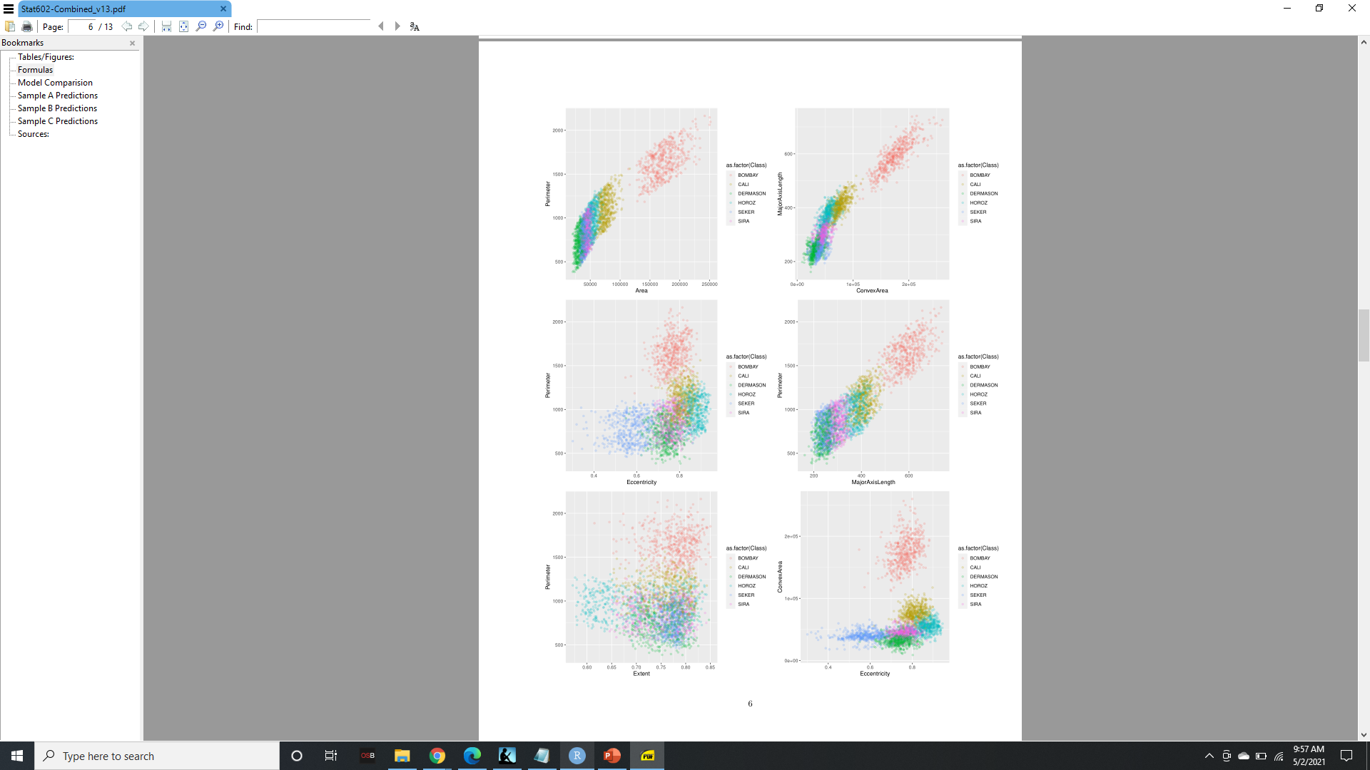
Observations through Exploratory Analysis (Cont…)

Slide 8
Observations through Exploratory Analysis (Cont…)

Slide 9
Observations through Exploratory Analysis (Cont…)

Slide 10
Methods/Models
Neural Network
Linear Discriminate Analysis
K-Nearest Neighbors
Support Vector Machine
Random Forest

Slide 11
Model Building Process
Exploratory Analysis of the data: Identify initial patterns and correlations
Pre-processing: By dummy encoding target variable or scaling the data
Dataset Splitting: Training data 80% and Testing data 20%
Feeding data to model: Train model by training data, test models using our chosen classification techniques
Error determination algorithm and formula to calculate metrics of price value accuracy.
Apply the algorithm and formula to the three sample sets.
Determine model selection and our final recommendation.

Slide 12
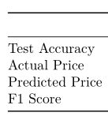

Model 1: Neural Network
Dummy encoding is used for target variables to handle classes that are factors with multiple levels.
Constructed NN with 3 hidden layers –
First hidden layer has 15 nodes
Second hidden layer has 10 nodes
Third hidden layer has 3 nodes
Logistic function is implemented to generate predicted probabilities for each class.
Neuron with the highest probability is taken and predicted that class to be the class for the bean.

Slide 13
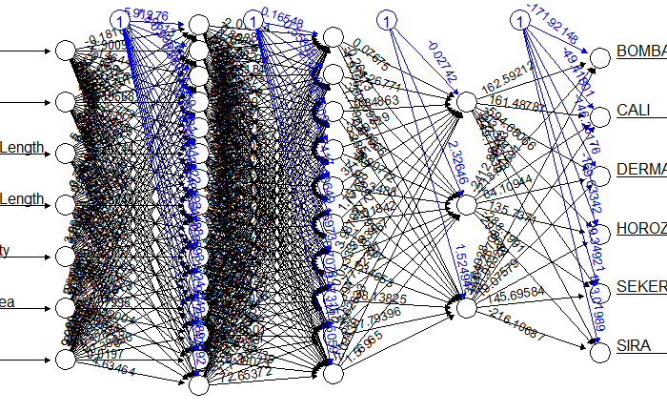
Model 1: Neural Network (Cont…)

Slide 14
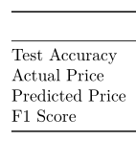

Model 2: Linear Discriminant Analysis
Attempts to maximize gap between classes.
Assumes that predictors are distributed normally.
Focuses on projecting features from higher dimension to lower.
Easily predicted and interpretable.
Determines the effectiveness of model in predicting the classes.

Slide 15
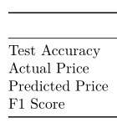

Model 3: KNN
Supervised, non-parametric method used for classification and sometimes regression.
Distance based algorithm; scaling data is part of the preprocessing.
k is the number of neighbors to be considered by the algorithm.
K is selected by taking square root of the no. of datasets in our case, K = 16.
Returns the predicted class label of each test instance based upon the most prevalent training class of its k closest neighbors.

Slide 16
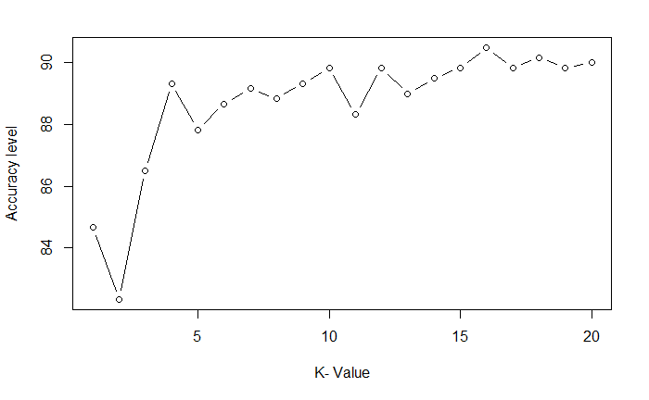
Model 3: KNN (Cont.…)

Slide 17
Model 4: Support Vector Machine
Supervised learning approach used in classification and regression problems.
SVM finds the optimal hyperplane that maximizes the margin between classes.
Uses hyperplanes as decision boundary to classify the data.
Effective in dealing with higher dimensional data.

Slide 18
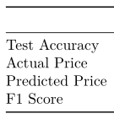

Model 4: Support Vector Machine (Cont..)
Used Caret package for the model analysis.
Data is linearly separable hence linear kernel is used.
Data is preprocessed at the center and scaled.
Tuning parameter C is default that is 1.
With trcontrol function data is resampled with the 10-fold CV approach and is repeated 3 times.
Model accuracy for labeled data: 89%

Slide 19
Model 5: Random Forest
Created in 1975 by Tin Kam Ho.
Supervised classification and regression algorithms.
Helps in dealing with missing values.
Provides ranking of variables respective to your case.
Can deal with large number of variables without having to delete variables.

Slide 20


Model 5: Random Forest (Cont.…)
Accuracy of Random Forest Model
Precision respective to Dry Beans Type

Slide 21
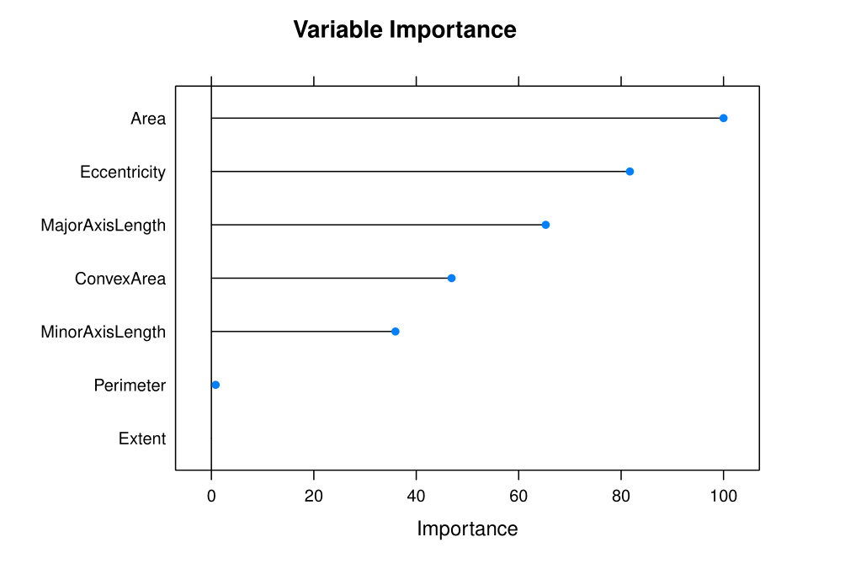
Model 5: Random Forest (Cont.…)

Slide 22
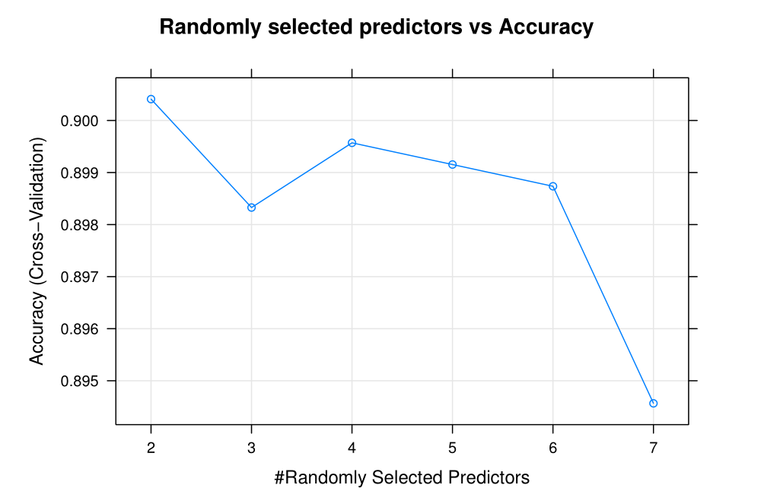
Model 5: Random Forest (Cont.…)

Slide 23
Calculating Accuracy for Unknown Data
For applying our classifiers and our algorithm to the sample data sets we designed a function in order to automate the process.
The function implements an algorithm that we designed that takes the predictions made by the selected model and derives from those predictions a “Calculated (Predicted) Price”, “Bean Counts” (how many of each class of bean is predicted to be in the sample), “Predicted Weight” ( how much the sample would weigh given the bean predictions), “Predicted Price Accuracy” (how confident we are in the predicted price of the sample), and “Error in Dollars” (how much we could possibly be off in our price prediction)

Slide 24
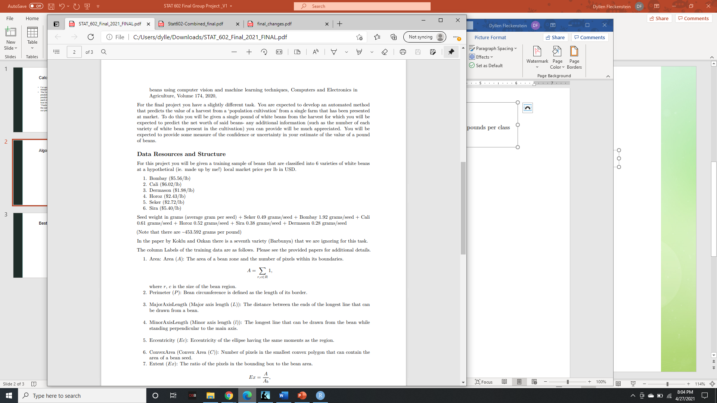
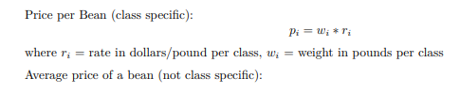
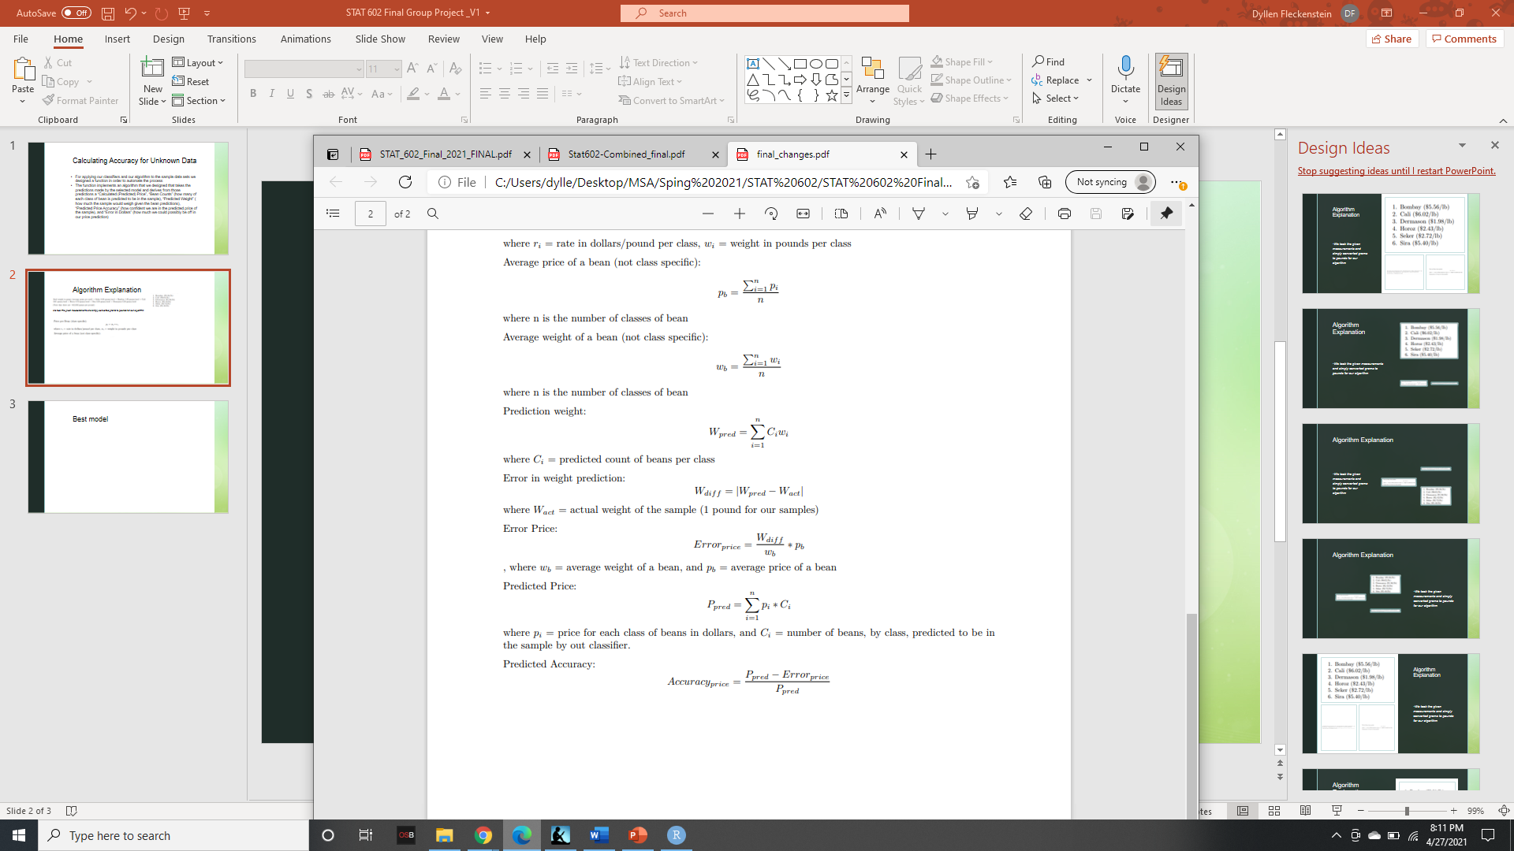
Algorithm Explanation
The first step was just predicting the price of the sample based upon the predicted bean counts from the model
We took the given measurements and simply converted grams to pounds for our algorithm

Slide 25
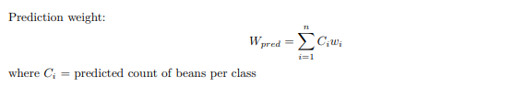

Algorithm Explanation (Cont…)
The next step is determining an error metric so we can calculate a predicted accuracy for our price prediction
Since we know how many beans are in our sample (number of rows in the data), we know how much the sample is supposed to weigh (1 pound) and we know how much on average one bean for each class weighs, there only exists a certain distribution of beans within the sample that maintains all these constraints
Therefore, we decided to develop some type of algorithm that gives a higher accuracy score to models whose prediction’s weight is close to the weight of the sample and a lower score to those whose prediction’s weight is not
First step: calculate how much the predicted sample weighs based upon the given average weight per bean for each class
Second step: determine how many pounds the prediction weight is off from the actual weight (1 pound for our samples)

Slide 26
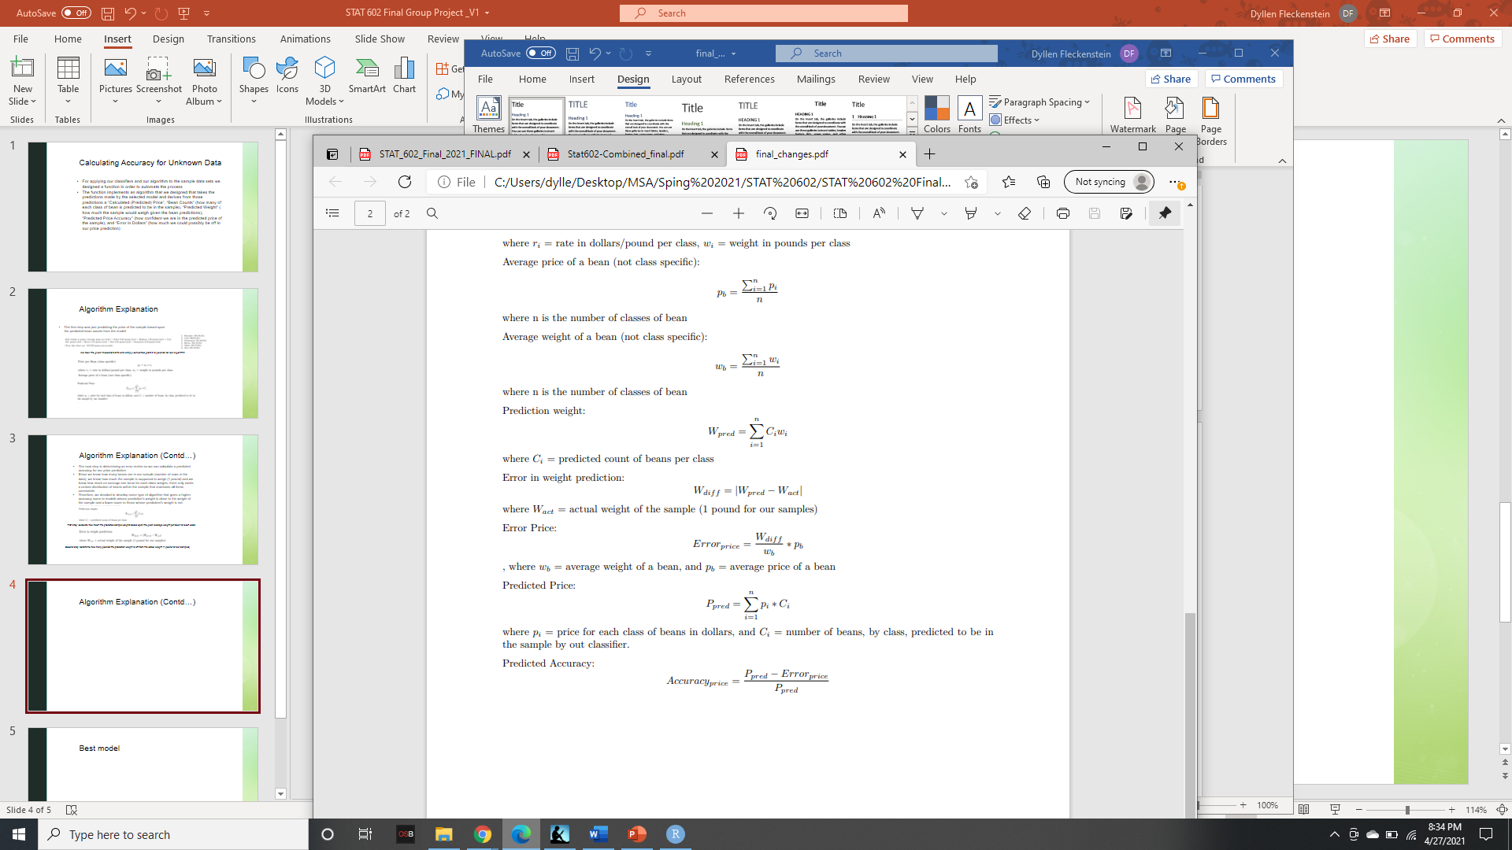
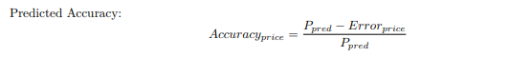
Algorithm Explanation (Cont…)
Third step: take the difference in weight between the sample and prediction and convert it to a count of beans (based upon average weight for a bean) and then convert that into a price (based upon average price for a bean)
Final step: calculate the predicted accuracy of the model’s price prediction

Slide 27
Model Evaluation
Used Accuracy and the F1-score to gauge training model’s performing.
F1-score tells us which model performs the best across all classes.
Selection is how well each performed on the sample data sets.

Slide 28
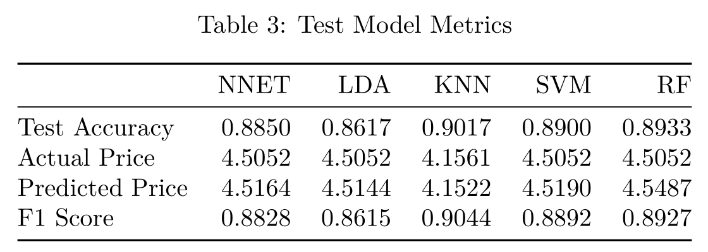
Model Comparison

Slide 29
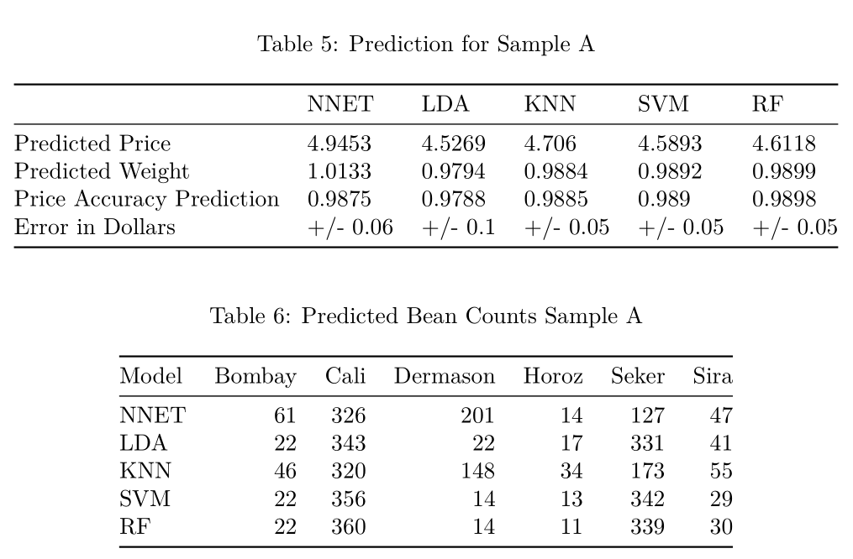
Results: Prediction for Sample-A

Slide 30
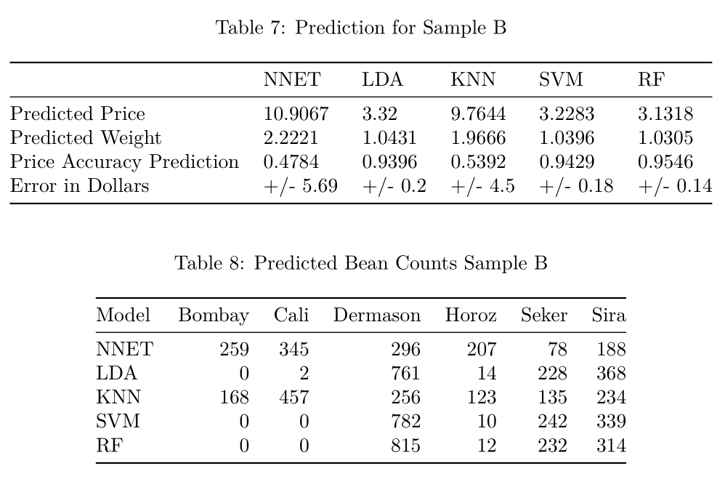
Results: Prediction for Sample-B

Slide 31
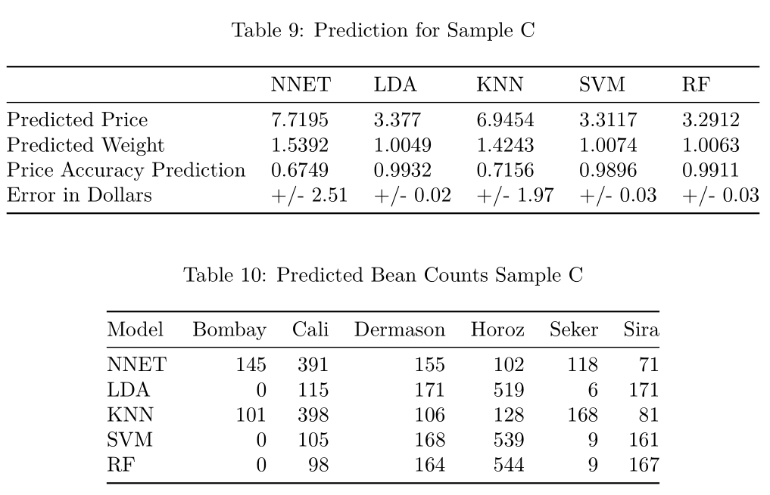
Results: Prediction for Sample-C

Slide 32
Recommendation
Recommended model: Random Forest
Model Accuracy: 89.3% and F1: 0.8927
Comparatively higher price accuracy for samples.
Weight for the samples is within constraints.

Slide 33
Sources
https://www.rdocumentation.org/packages/neuralnet
https://www.edureka.co/blog/knn-algorithm-in-r/
https://rstudiopubsstatic.s3.amazonaws.com/316172_a857ca788d1441f8be1bcd1e31f0e875.html
https://www.edureka.co/blog/random-forest-classifier/
https://www.blopig.com/blog/2017/04/a-very-basic-introduction-to-random-forests-using-r/
https://github.com/mariocastro73/ML2020-2021/blob/master/scripts/caret-rf.R
https://www.edureka.co/blog/support-vector-machine-in-r/
https://www.r-project.org/conferences/useR-2013/Tutorials/kuhn/user_caret_2up.pdf
KOKLU, M. and OZKAN, I.A., (2020), “Multiclass Classification of Dry Beans Using Computer Vision and Machine Learning Techniques.” Computers and Electronics in Agriculture, 174, 105507.
Saunders,Christopher.(2018).FinalLDAExample. https://d2l.sdbor.edu/d2l/le/content/1543761/ viewContent/8840088/View

Slide 34
Thank you!!

Slide 35
Any Questions?

